Slide 1
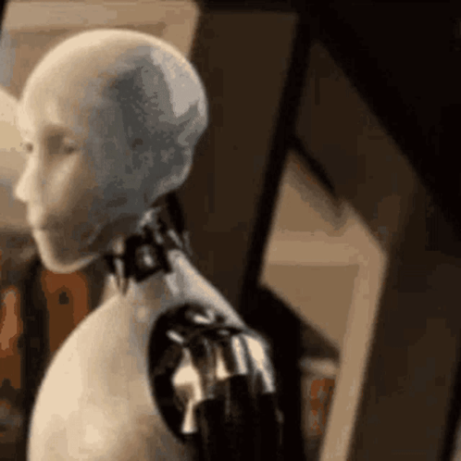
Building a conversational agent

Slide 2
Index
Intent Classification
Training results
Cross entropy loss
Adam optimizer
Marbel agent
Marbel visualization

Slide 3
Intent classification
-neural multi-task model
- trained and evaluated
- default hyperparameters
- run_train_test.py

Slide 4
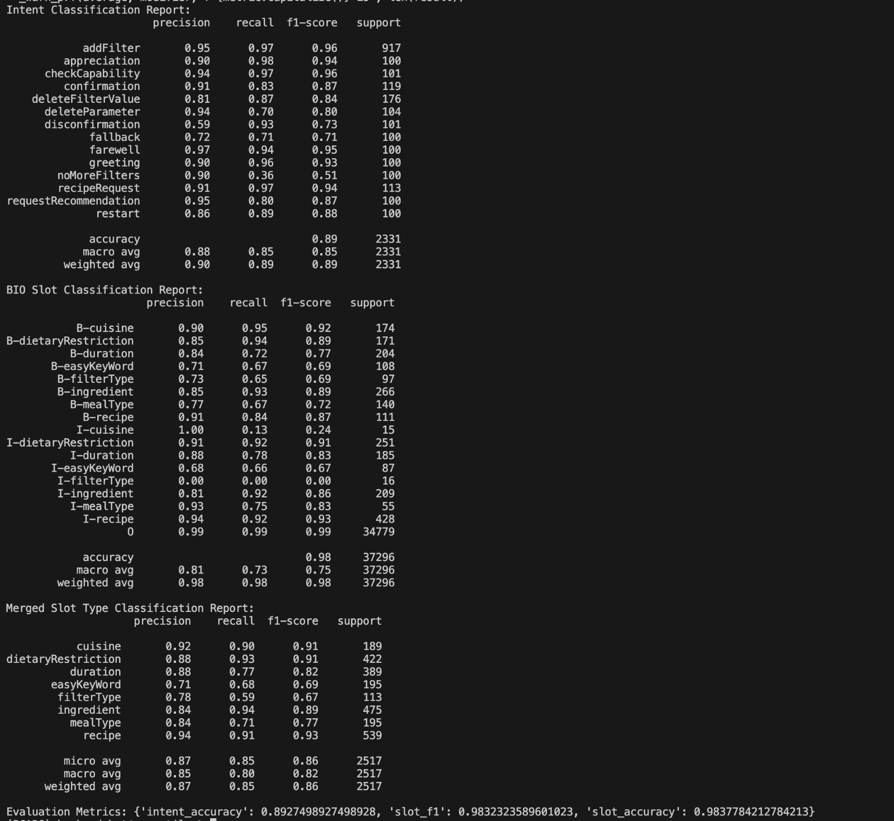
Training results

Slide 5
Why Cross-Entropy Loss?
-Intent classification:
-Multi class classification
Slot filling:
-multi class classification on token level(BIO tags)
- cross entropy per token

Slide 6
Why Adam Optimizer?
Adaptive learning rate per parameter
Combines momentum and RMSProp
Also robust to noisy and sparse gradients.
-Strong default choice for deep models

Slide 7
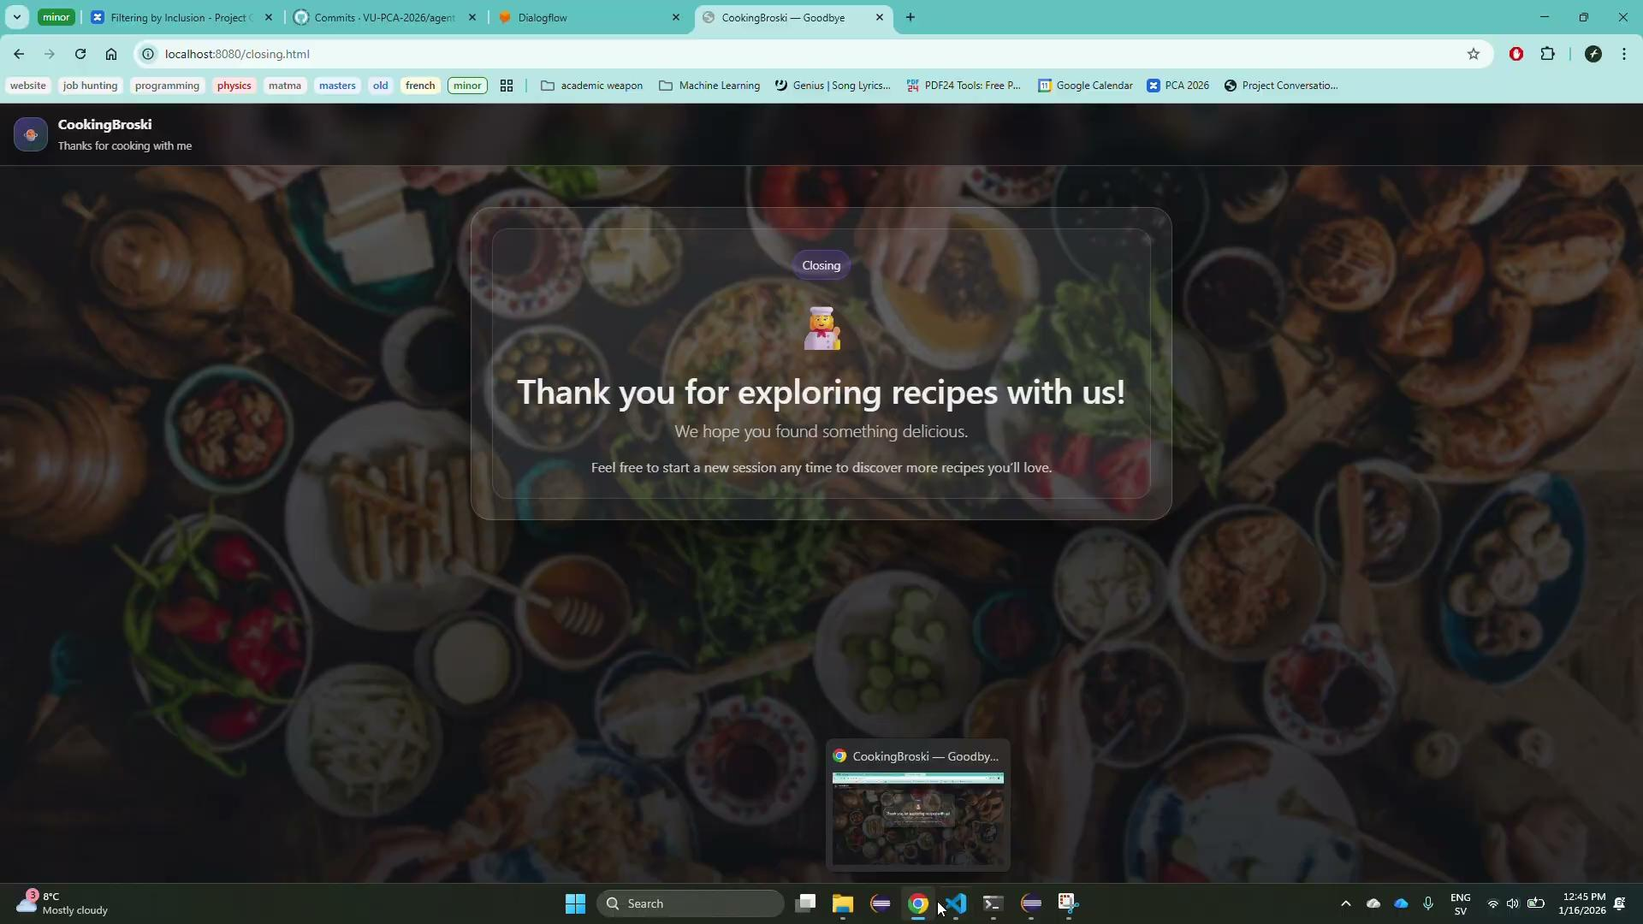

Slide 8
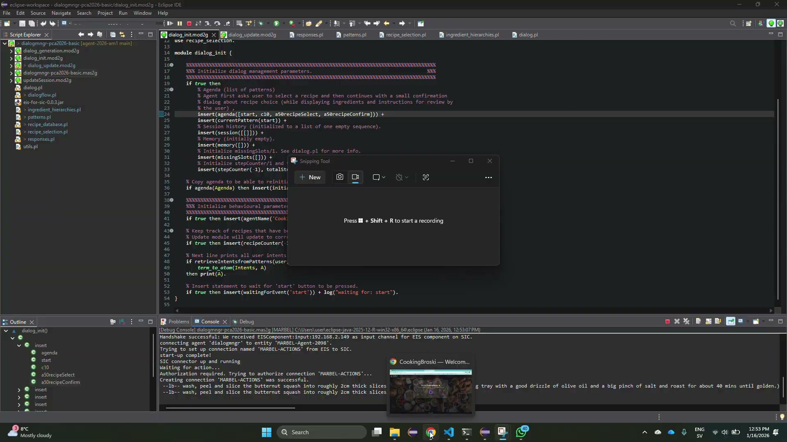

Slide 9

Thanks!

